Slide 1

Overview of the IC Architecture and Its Components

Slide 2




Content
1
Explanation of the Traditional Network
2
ICP vs Traditional Network
3
Core IC Protocol
4
Architecture of the Internet Computer
5
Conclusion

Slide 3
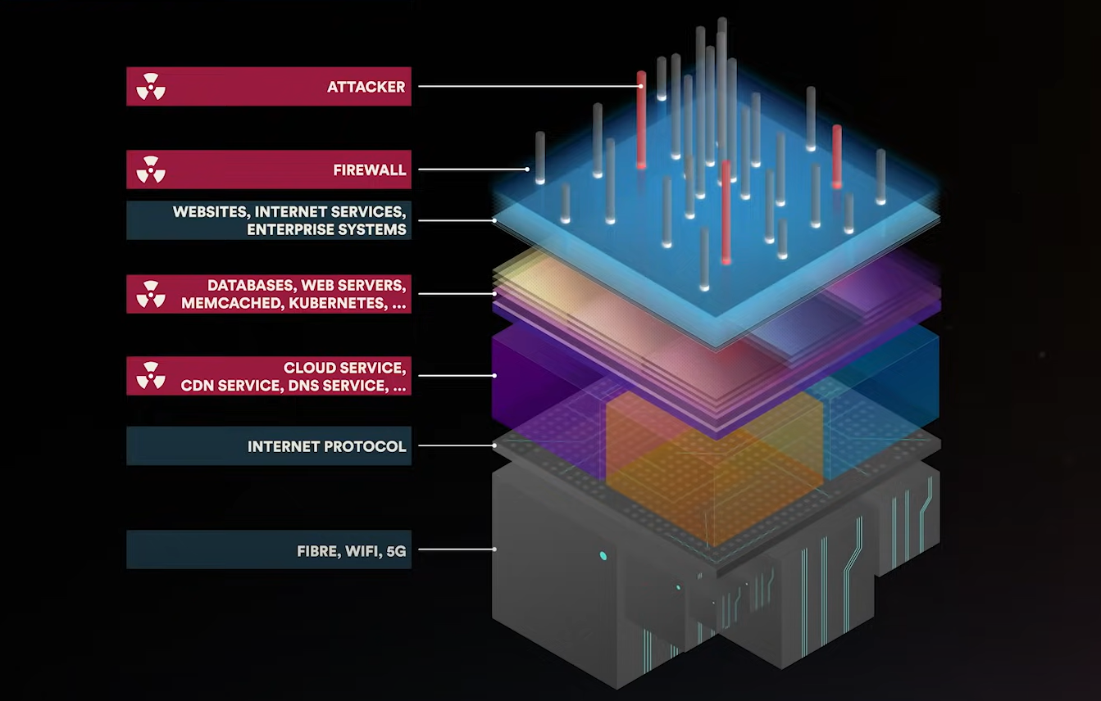
Explanation of the Traditional Network

Slide 4

ICP vs Traditional Network
Traditional Network
IC Protocol
Limited Scalability
High Scalability
Lack of Security
Chain Key Technology
Dependence on Centralized Servers
Network Nervous System (NNS)
Inefficient Resource Use
Security
Lack of Interoperability
Notes:
dfx: dfx is the command-line tool provided by DFINITY for developing, deploying, and managing applications on the Internet Computer. It is designed to facilitate local development and testing.
moc: moc stands for "Motoko Compiler". Motoko is a programming language that has been specifically designed for creating software to run on the Internet Computer. The moc is used to compile Motoko source code into WebAssembly (Wasm) format, which can be executed on the Internet Computer.
replica: In the context of the Internet Computer, a replica refers to an instance of the Internet Computer Protocol running on a node machine. Multiple replicas form a subnet, and they work together to process requests, maintain a shared state, and preserve the integrity and security of the system.
network binary: This term usually refers to the compiled version of the Internet Computer software that is run on the node machines. It includes the code necessary to operate the network, process requests, and maintain the blockchain.
uninstall.sh: This is a shell script file that is typically used to uninstall software in a Unix or Unix-like operating system. In the context of the Internet Computer, it would be used to remove the installed software or tools related to the Internet Computer from your system.
versions: This term in a software context generally refers to the different releases of a particular software package. Each version would have different features or improvements. In the context of the Internet Computer, it could refer to the different releases of the dfx tool, the Internet Computer software, or other related tools and libraries.

Slide 5

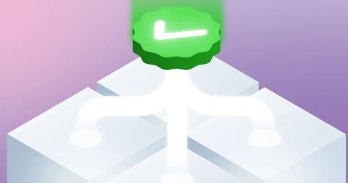
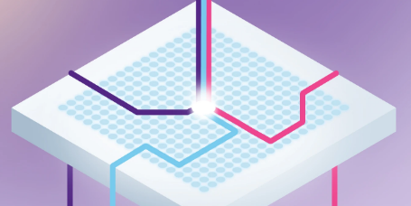
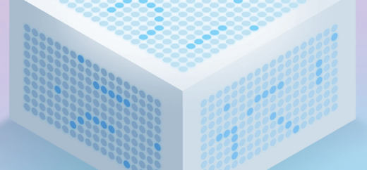
Core 4-Layer Protocol
Peer-to-Peer Layer
Consensus Layer
Message Routing Layer
Execution Layer

Slide 6
Architecture of the Internet Computer
Peer-to-Peer: The Peer-to-Peer (P2P) layer in the Internet Computer Protocol ensures secure communication between nodes within a subnet. It allows nodes to broadcast messages or "artifacts" to all other nodes, guaranteeing their delivery.
Consensus: The IC protocol uses a consensus mechanism to agree on and order messages. It provides instant finality, high throughput, and robustness, unlike Bitcoin's probabilistic finality.
Message Routing: Handles the induction and routing of messages between canisters, potentially across different subnets. It ensures consistent message processing across all nodes in a subnet and enables inter-subnet communication (XNet messaging).
Execution: The Execution layer is the top layer of the Internet Computer Protocol, executing canister smart contract code using a WebAssembly virtual machine on each node.

Slide 7
Conclusion
The Internet Computer's architecture is powered by the Internet Computer Protocol (ICP), consisting of four layers:
Peer-to-Peer
Consensus
Message Routing
Execution, facilitating efficient blockchain operations
Notes:
dfx: dfx is the command-line tool provided by DFINITY for developing, deploying, and managing applications on the Internet Computer. It is designed to facilitate local development and testing.
moc: moc stands for "Motoko Compiler". Motoko is a programming language that has been specifically designed for creating software to run on the Internet Computer. The moc is used to compile Motoko source code into WebAssembly (Wasm) format, which can be executed on the Internet Computer.
replica: In the context of the Internet Computer, a replica refers to an instance of the Internet Computer Protocol running on a node machine. Multiple replicas form a subnet, and they work together to process requests, maintain a shared state, and preserve the integrity and security of the system.
network binary: This term usually refers to the compiled version of the Internet Computer software that is run on the node machines. It includes the code necessary to operate the network, process requests, and maintain the blockchain.
uninstall.sh: This is a shell script file that is typically used to uninstall software in a Unix or Unix-like operating system. In the context of the Internet Computer, it would be used to remove the installed software or tools related to the Internet Computer from your system.
versions: This term in a software context generally refers to the different releases of a particular software package. Each version would have different features or improvements. In the context of the Internet Computer, it could refer to the different releases of the dfx tool, the Internet Computer software, or other related tools and libraries.

